Slide 1
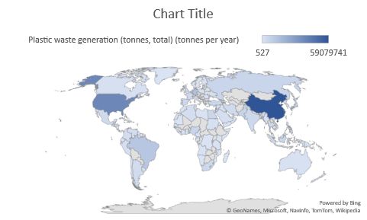

Slide 2
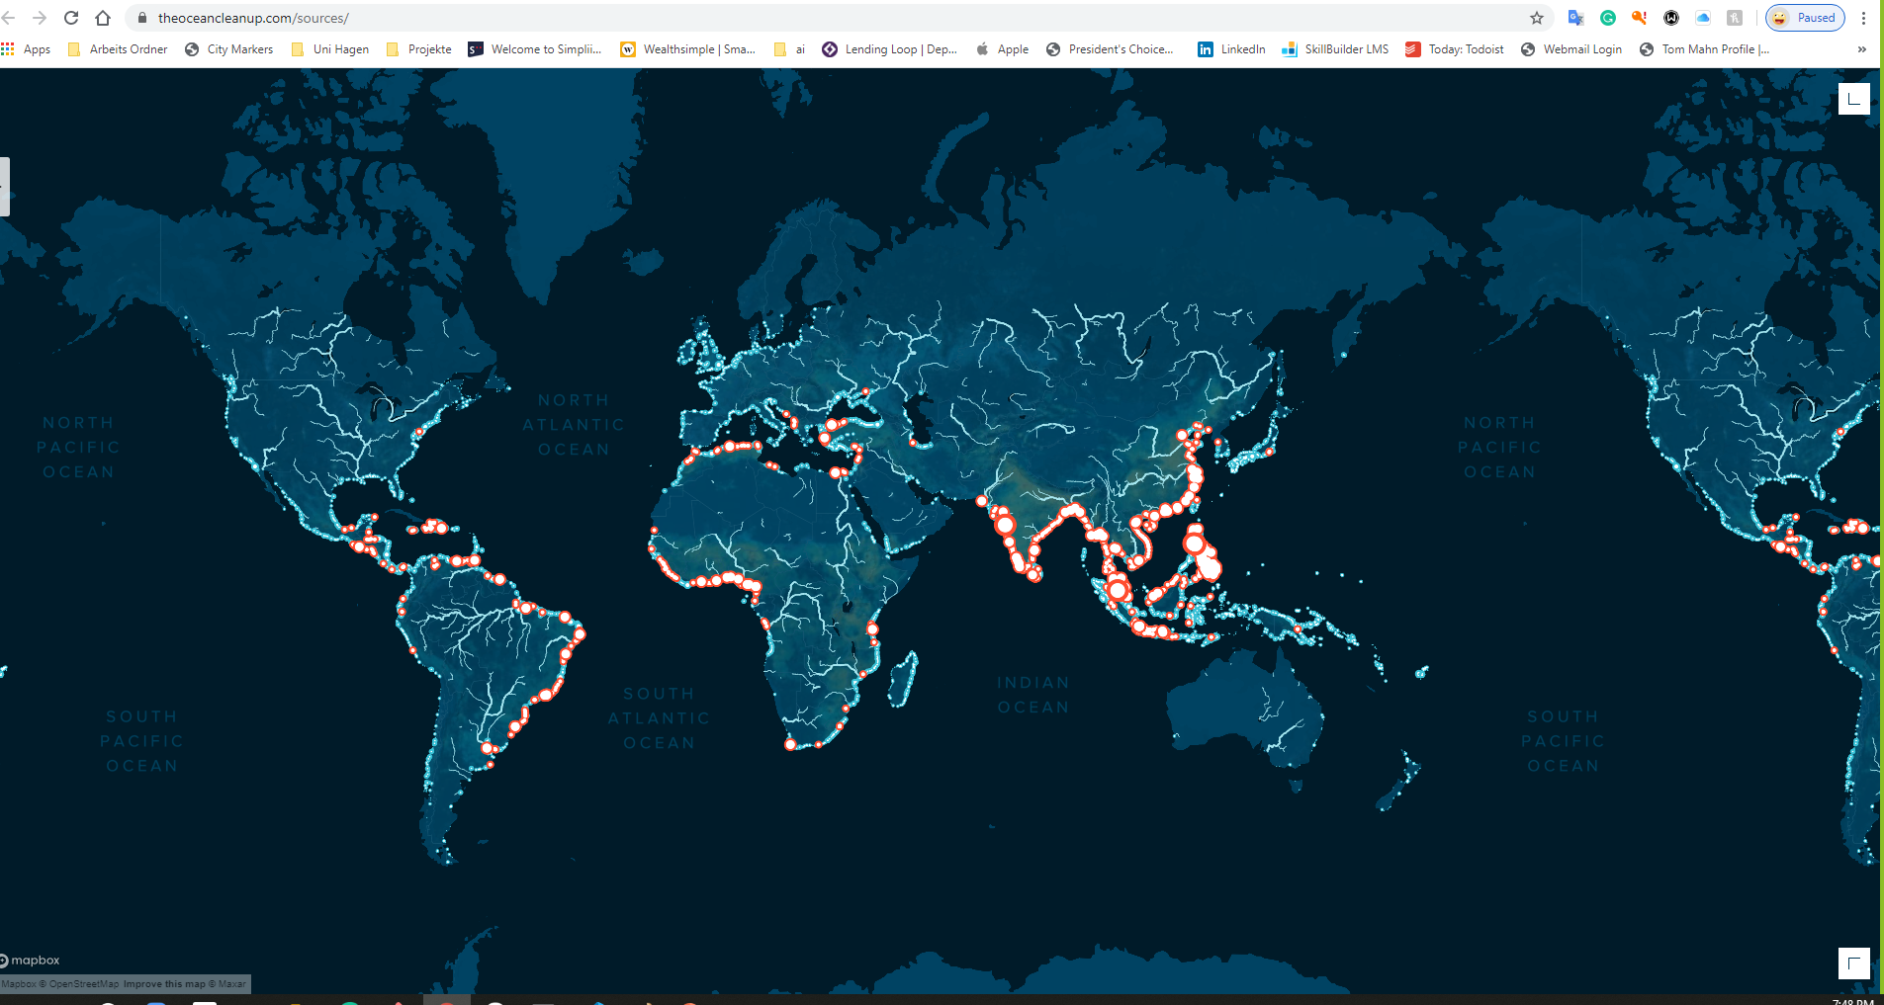

Slide 3
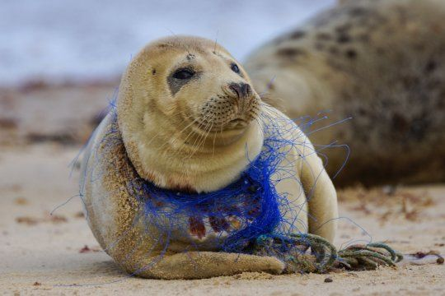
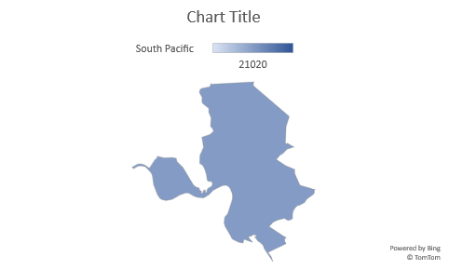
Study | Animal | Encounter type | Predominant debris type | Impact (response)
Allen et al. 2012 | Grey seals | Entanglement | MF line, net, rope | Constriction
Beck & Barros, 1991 | Manatees | Entanglement | MF line, bags, other debris | Death
Campagna et al. 2007 | Elephant seals | Entanglement | MF line, fishing jigs | Dermal wound
Croxall et al. 1990 | Fur seals | Entanglement | Packing band, fishing gear, other debris | Dermal wound
Dau et al. 2009 | Seabirds, pinnipeds | Entanglement | Fishing gear | External wound
Fowler 1987 | Fur seals | Entanglement | Trawl netting, packing bands | Death
Fowler 1987 (correlative evidence only) | Fur seals | Entanglement | Trawl netting, packing bands | Reduced population size
Good et al. 2010 | Invertebrates, fish, seabirds, marine mammals | Entanglement | Derelict gillnets | Death
Moore et al. 2009 | Seabirds, marine mammals | Entanglement | Plastic, fishing line | Death
Pham et al. 2013 | Gorgonians | Entanglement | Fishing line | Damage/breakage
Velez-Rubio et al. 2013 | Sea turtles | Entanglement | Fishing gear | Death
Winn et al. 2008 | Whales | Entanglement | Plastic line | Dermal wound
Woodward et al. 2006 | Whales | Entanglement | Plastic line | Dermal wound
Beck & Barros 1991 | Manatees | Ingestion | MF line, bags, other debris | Death
Bjorndal et al. 1994 | Sea turtles | Ingestion | MF line, fish hooks, other debris | Intestinal blockage, death
Brandao et al. 2011 | Penguins | Ingestion | Plastic, fishing gear, other debris
Browne et al. 2013 | Lugworms (laboratory) | Ingestion | Microplastics | Biochemical/cellular, death
Bugoni et al. 2001 | Sea turtles | Ingestion | Plastic bags, ropes | Gut obstruction, death
Carey 2011 | Seabirds | Ingestion | Plastic particles, pellets | Perforated gut
Cedervall et al. 2012 | Fish (laboratory) | Ingestion | Nanoparticles | Biochemical/cellular
Connors & Smith 1982 (correlative evidence only) | Seabirds | Ingestion | Plastic pellets, foam | Biochemical/cellular
Dau et al. 2009 | Seabirds, pinnipeds | Ingestion | Fishing hooks | Internal wound
de Stephanis et al. 2013 | Sperm whale | Ingestion | Identifiable litter items | Gastric rupture, death
Fry et al. 1987 | Seabirds | Ingestion | Plastic fragments, pellets, identifiable litter | Gut impaction, ulcerative lesions
Jacobsen et al. 2010 | Sperm whales | Ingestion | Fishing gear, other debris | Gastric rupture, gut impaction, death
Lee et al. 2013 | Copepods (laboratory) | Ingestion | Micro- and nanoplastics | Death
Oliveira et al. 2013 | Fish (laboratory) | Ingestion | Microplastics | Biochemical/cellular
Rochman et al. 2013a-c | Fish (laboratory) | Ingestion | Microplastics | Biochemical/cellular
Ryan 1988 | Birds (laboratory) | Ingestion | Microplastics | Reduced organ size
Velez-Rubio et al. 2013 | Sea turtles | Ingestion | Marine debris | Gut obstruction
Wright et al. 2013 | Lugworms (laboratory) | Ingestion | Microplastics | Biochemical/cellular
Von Moos et al. 2012 | Mussels (laboratory) | Ingestion and gill uptake | Microplastics | Biochemical/cellular
Katsanevakis et al. 2007 | Epibenthic megafauna | Interaction (contact) | Plastic bottles, glass jars | Altered assemblage
Lewis et al. 2009 | Sessile invertebrates (coral reef) | Interaction (contact) | Lobster traps | Altered assemblage
Uneputty & Evans 1997 (correlative evidence only) | Assemblage on sediment | Interaction (contact) | Plastic litter | Altered assemblage
Chiappone et al. 2002 | Sessile invertebrates (coral reef) | Interaction (contact) | MF line, lobster trap, hook and line gear | Tissue abrasion
Chiappone et al. 2005 | Sessile invertebrates (coral reef) | Interaction (contact) | Hook and line gear | Tissue abrasion
Uhrin & Schellinger 2011 | Seagrass | Interaction (contact) | Crab pots, tires, wood | Breakage, suffocation, death
Ozdilek et al. 2006 (correlative evidence only) | Sea turtles | Interaction (obstruction) | Waste, medical waste | Reduced population size
Widmer & Hennemann 2010 (correlative evidence only) | Ghost crabs | Interaction (obstruction) | Beach litter, mostly plastic | Reduced population size
Widmer & Hennemann 2010 (correlative evidence only) | Ghost crabs | Interaction (substrate) | Beach litter, mostly plastic | Altered assemblage
Goldstein et al. 2012 (correlative evidence only) | Marine insects | Interaction (substrate) | Microplastics | Increased population size
Sadness Gallary

Slide 4
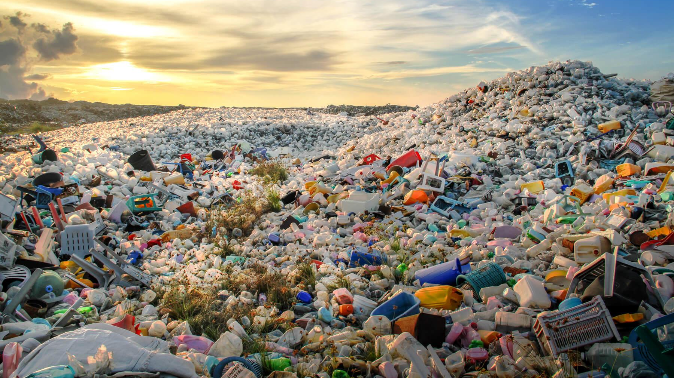
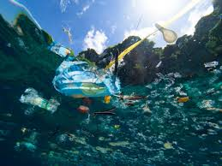
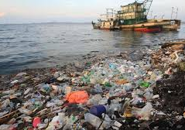
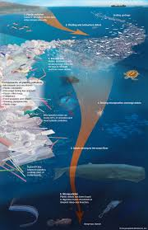

Slide 5
